Slide 1
Statistical Inference: Case Study

Slide 2
Session Pedagogy
Data Understanding
Business Objective given
Class Discussion to
Conceptualize the Output
Approach the Analysis in R
Participants Create the R code independently
Final code and output shown
Notes:
How to detect outliers<-Boxplot

Slide 3
Background
Large FMCG company
Pan country presence
3 business lines- Ice Cream, Chocolates and Cakes-Biscuits
Large amount of data is available

Slide 4
Supply Chain
Company
Wholesalers
Retailers
Consumers
‘Customer’ in our case study

Slide 5
Data Snapshots
Customer Profile Data
NPS Data
Market survey data is available for 107 customers(NPS Data). The survey
recorded ‘Net promoter Score’ .
Net Promoter Scores are based on response to single question (0-10 scale)
How likely is it that you would recommend [brand] to a friend or colleague?

Slide 6
Get Started
Import data sets: CUST_PROFILE and NPSDATA.
CUST_PROFILE data has custid and region.
NPSDATA has custid and Net Promoter Score measured on 0-10 scale.
Import and check dimensions and number of unique customers in each data set.
Merge two data sets.

Slide 7
Get Started- R codes and output
custprofile<-read.csv(file.choose(),header=T)
npsdata<-read.csv(file.choose(),header=T)
dim(custprofile)
[1] 15001 2
dim(npsdata)
[1] 107 2
length(unique(custprofile$CUSTID))
[1] 15001
length(unique(npsdata$CUSTID))
[1] 107

Slide 8
Get Started- R codes and output Merging Two Data Sets
npsregion<-merge(npsdata,custprofile,by="CUSTID",all.x=T)
head(npsregion)
CUSTID NPS REGION
1 10155 8 South
2 10211 7 West
3 10271 7 North
4 10477 9 South
5 10535 8 West
6 10564 7 South

Slide 9
1. Assessing Net Promoter Score
What is the Net Promoter Score on an average?
Suggestion: Use median as well as mean since the measurement scale is ordinal.(median is better measure)
Describe NPS graphically.
Suggestion: Use Box-Whisker plot or bar chart to plot median

Slide 10
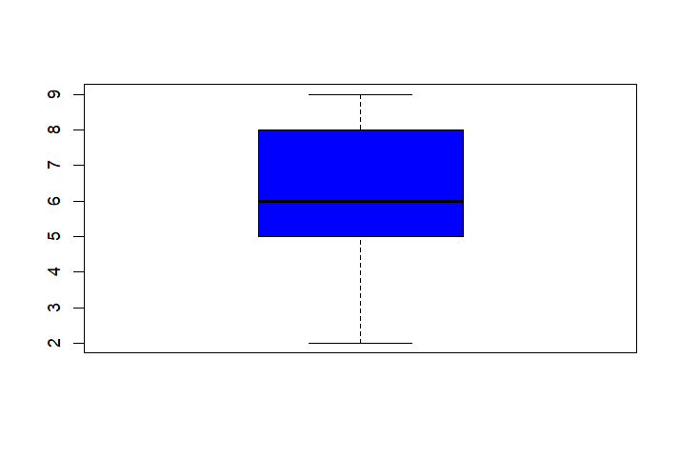
Assessing Net Promoter Score R Code and Output
> round(length(npsregion$NPS),0)
[1] 107
> round(mean(npsregion$NPS),2)
[1] 6.2
> round(median(npsregion$NPS),2)
[1] 6
boxplot(npsregion$NPS,col="blue")

Slide 11
2. Is NPS significantly more than '6'?
Which test to be used?
Can we assume 'Normality' of the distribution?
Is NPS significantly more than '6'?

Slide 12
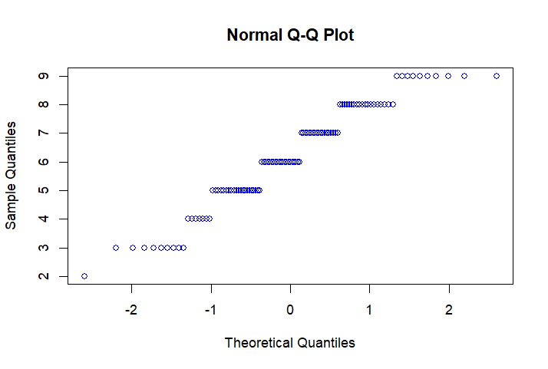
Can we assume 'Normality' of the distribution? R Code and Output
boxplot(npsregion$NPS,col="blue")
qqnorm(npsregion$NPS,col="blue")
shapiro.test(npsregion$NPS)
Shapiro-Wilk normality test
data: NPS
W = 0.94709, p-value = 0.000326
library(nortest)
lillie.test(npsregion$NPS)
Lilliefors (Kolmogorov-Smirnov) normality test
data: NPS
D = 0.12501, p-value = 0.0002978

Slide 13
Is NPS significantly more than '6'? R Code and Output
wilcox.test(npsregion$NPS,mu=6,alternative="greater")
Wilcoxon signed rank test with continuity correction
data: NPS
V = 2166, p-value = 0.0989
alternative hypothesis: true location is greater than 6
Conclusion: Do not reject H0. Average NPS is not significantly more
than '6'.

Slide 14
3. Compare NPS Region-wise
Which region has on an average highest NPS?
Suggestion: Use mean as well as median.
Is region wise difference in NPS significantly different?
Present region wise NPS graphically.

Slide 15
Which region has on an average highest NPS? R Code and Output
aggregate(NPS~REGION,data=npsregion,FUN=mean)
REGION NPS
1 East 6.250000
2 North 6.208333
3 South 6.057143
4. West 6.321429
aggregate(NPS~REGION,data=npsregion,FUN=median)
REGION NPS
1 East 6
2 North 6
3 South 6
4 West 7

Slide 16
Is region wise difference in NPS significantly different? R Code and Output
kruskal.test(NPS~REGION,data=npsregion)
Kruskal-Wallis rank sum test
data: NPS by REGION
Kruskal-Wallis chi-squared = 0.52336, df = 3, p-value = 0.9137
Region wise difference in NPS is not significant.

Slide 17
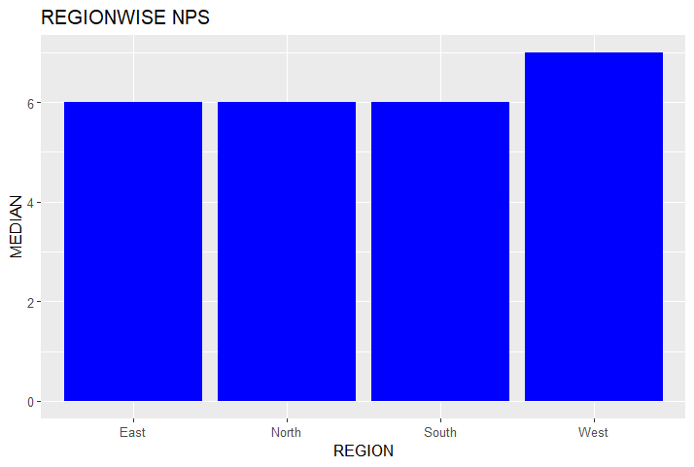
Median NPS -Bar Diagram
med<-aggregate(NPS~REGION,data=npsregion,FUN=median)
library(ggplot2)
ggplot(med,aes(x=REGION,y=NPS))+
geom_bar(stat="identity",fill="blue")+
labs(x="REGION",y="MEDIAN",title="REGIONWISE NPS")

Slide 18
4. Detractors vs. Non-detractors
What percentage of customers are 'detractors'?
Detractor: NPS score of less than or equal to 6
Suggestion: Derive a new variable 'detractor' having values 'YES' or 'NO'.
Is percentage of detractors significantly greater than 40%?

Slide 19
What percentage of customers are 'detractors'? R Code and Output
npsregion$detractor[npsregion$NPS<=6]<-"YES"
npsregion$detractor[npsregion$NPS>6]<-"NO"
head(npsregion)
t<-table(npsregion$detractor)
t
______
detractor
NO YES
48 59
_______
prop.table(t)
detractor
NO YES
0.4485981 0.5514019
55% are detractors

Slide 20
Is percentage of detractors significantly greater than 40%? R Code and Output
prop.test(t["YES"],sum(t),0.4,alternative='greater')
1-sample proportions test with continuity correction
data: t["YES"] out of sum(t), null probability 0.4
X-squared = 9.5985, df = 1, p-value = 0.0009737
alternative hypothesis: true p is greater than 0.4
95 percent confidence interval:
0.4673912 1.0000000
sample estimates:
p
0.5514019
% of detractors significantly more than 40%.

Slide 21
5. Association between region and detractor(Y/N)
Summarize 'detractor' by region.
Test for association between region and detractor(Y/N)
Suggestion: Use 'gmodels' package.

Slide 22
Testing Association R Code and Output
library(gmodels)
CrossTable(npsregion$REGION, npsregion$detractor,prop.c=FALSE,prop.t=FALSE,
prop.chisq=FALSE,chisq=TRUE)
Statistics for All Table Factors
Pearson's Chi-squared test
------------------------------------------------------------
Chi^2 = 1.711052 d.f. = 3 p = 0.6344795
No association between Region and ‘detractor’

Slide 23
THANK YOU!

